Slide 1

The Data Mining Process
Mining Massive Datasets
Prof. Carlos "ChaTo" Castillo (they/them)
https://github.com/chatox/data-mining-course/

Slide 2
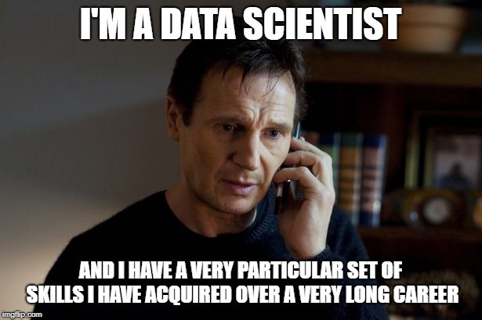
Taken (2008)

Slide 3
Main Sources
Data Mining, The Textbook (2015) by Charu Aggarwal (Chapter 1) + slides by Lijun Zhang
Mining of Massive Datasets, 2nd edition (2014) by Leskovec et al. (Chapter 1)
Data Mining Concepts and Techniques, 3rd edition (2011) by Han et al. (Chapters 1-2)

Slide 4
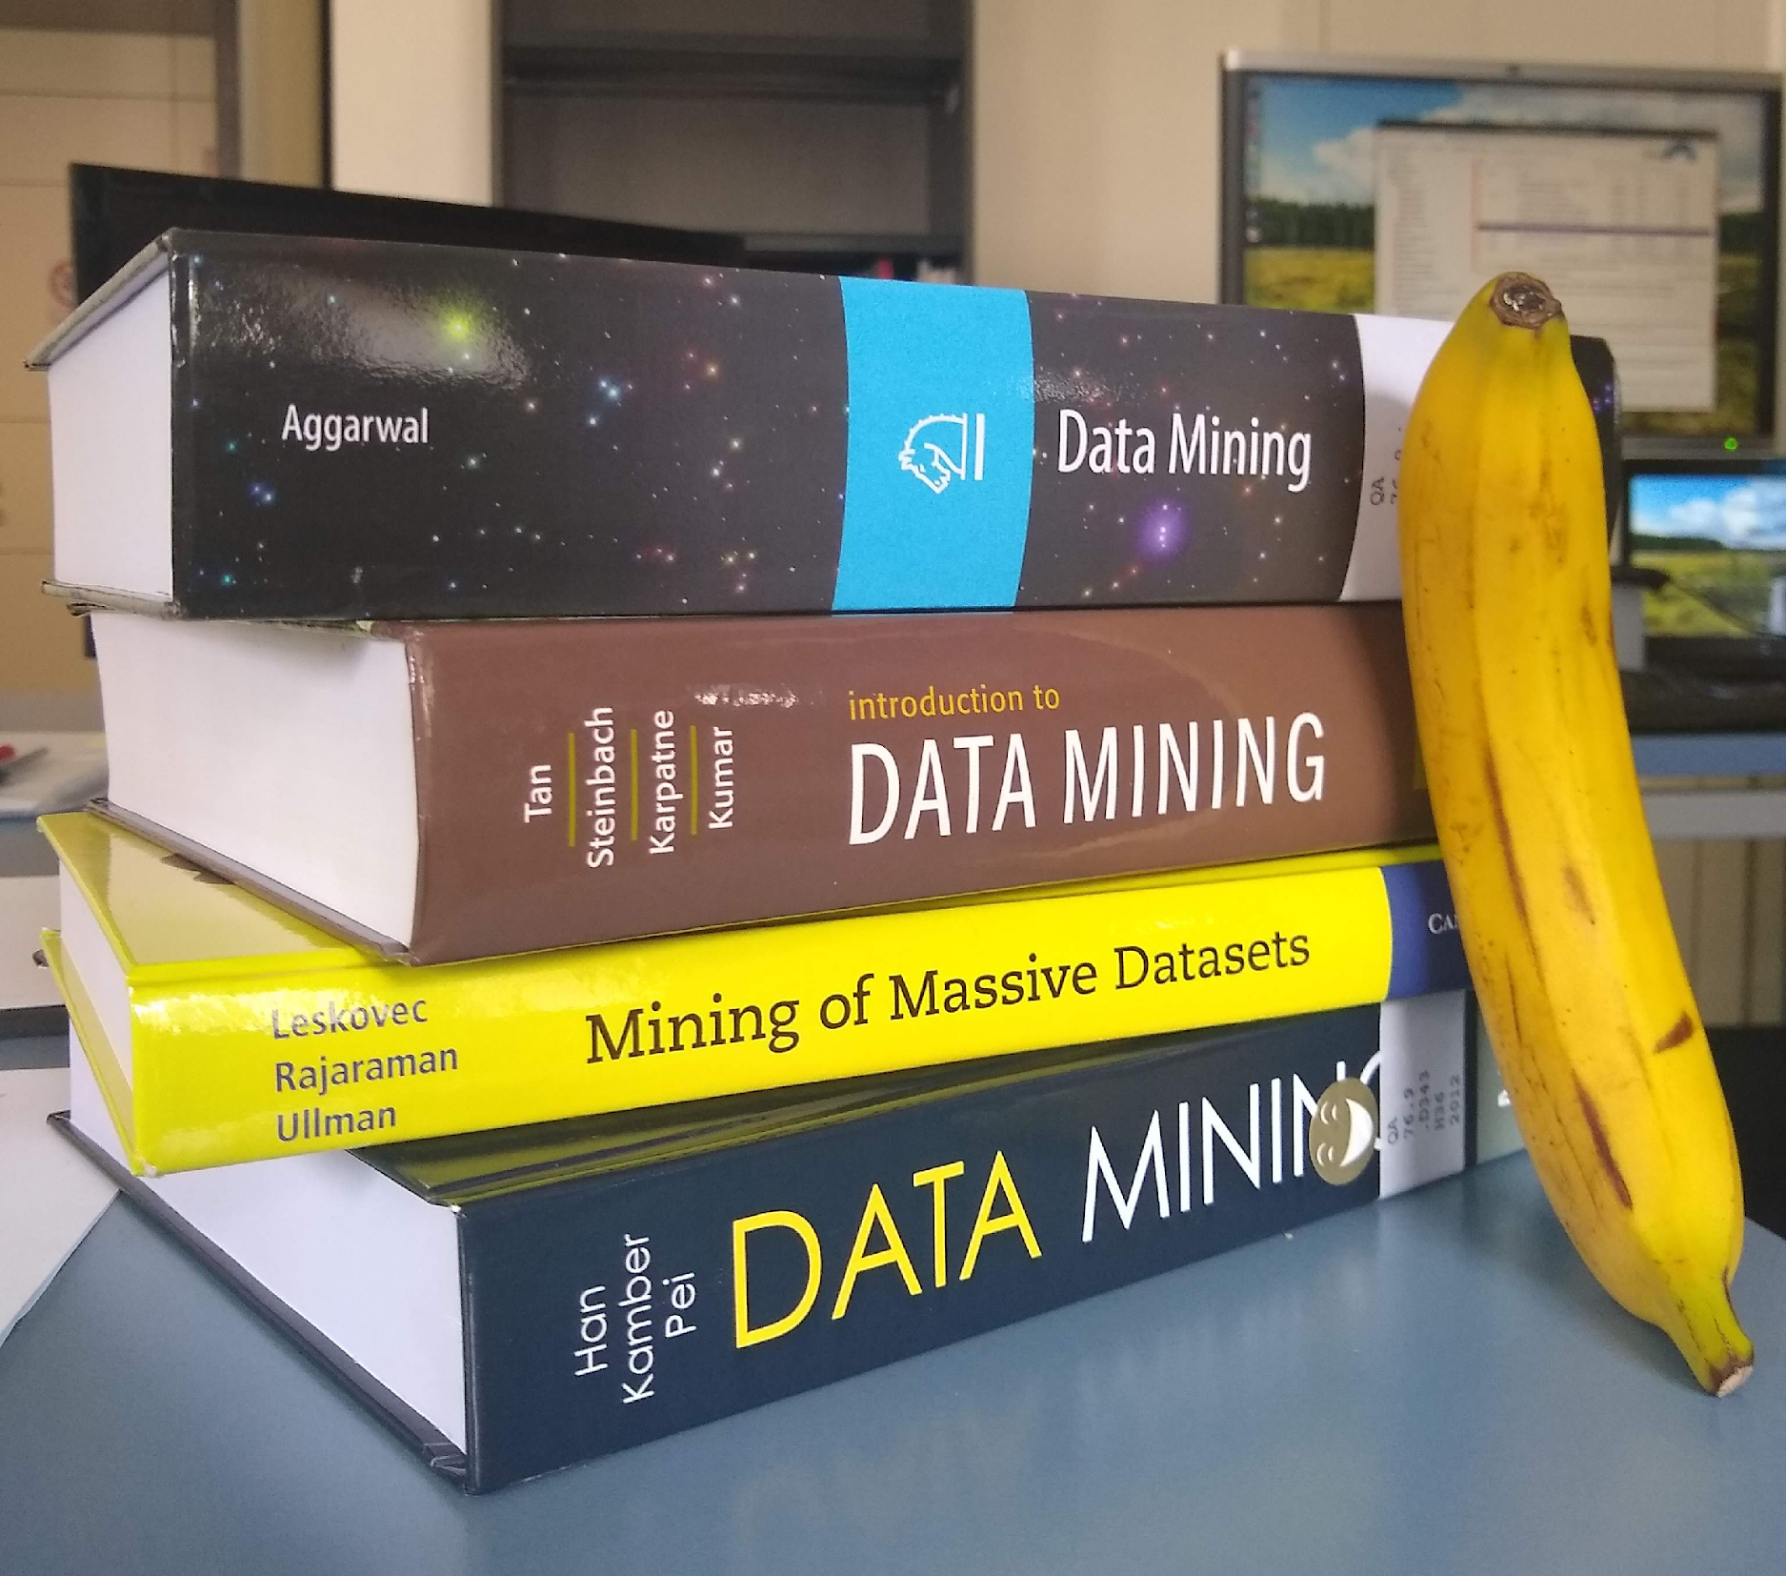
(Banana for scale)

Slide 5
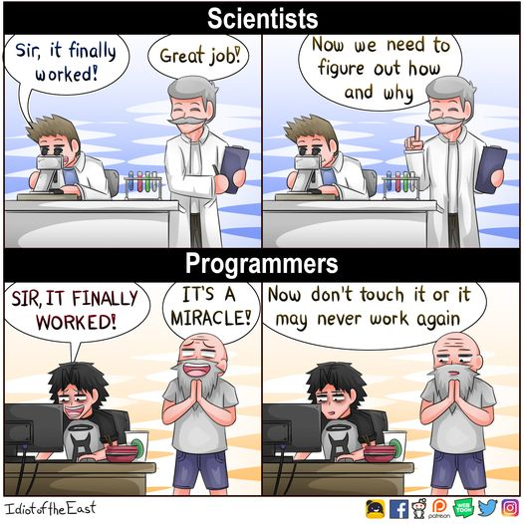

Slide 6
Data Mining

Slide 7
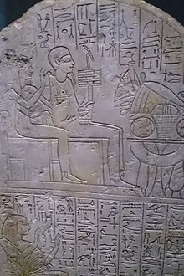
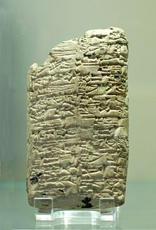
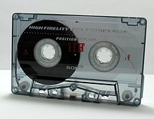
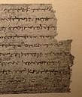
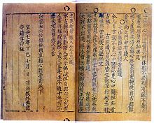
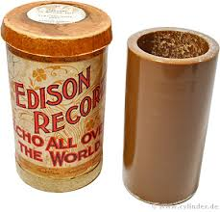
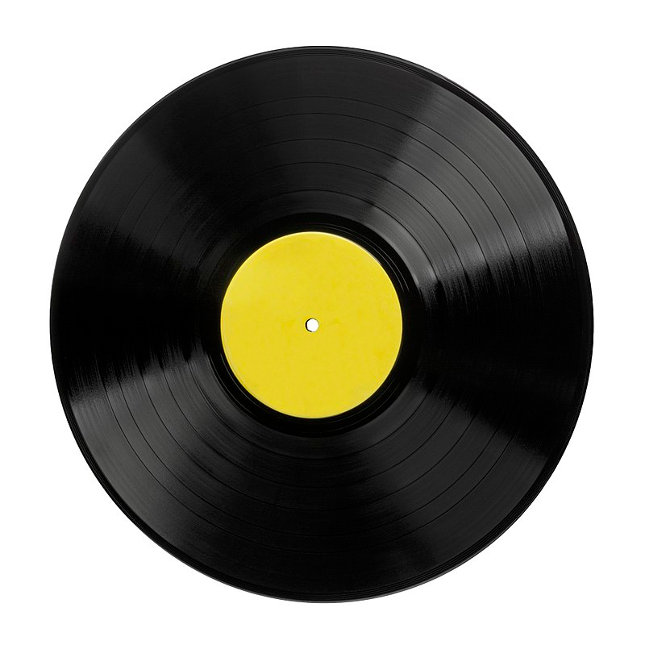
What do these have in common?
Tape
Stone
Clay
Papyrus
Paper
Wax cylinder
https://en.wikipedia.org/wiki/Writing
Vinyl

Slide 8
(Answer: they are analog)

Slide 9
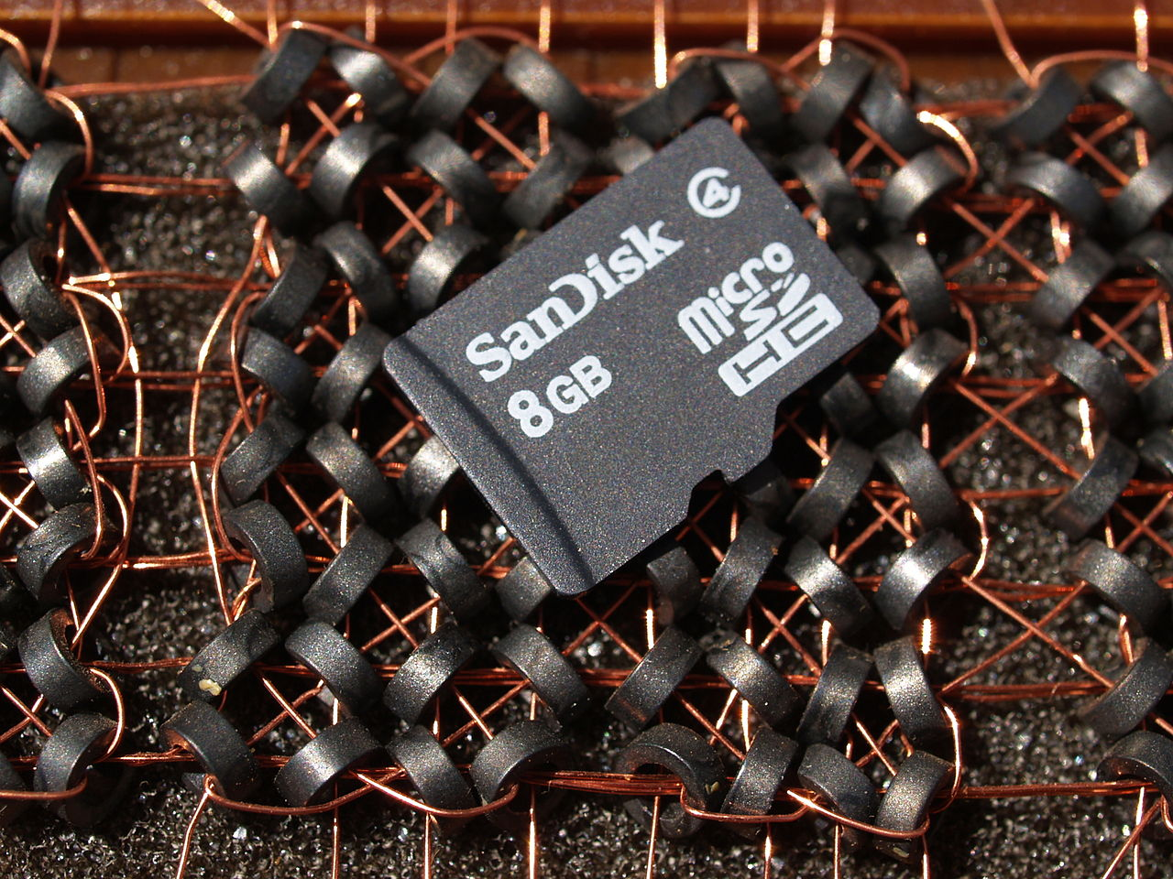
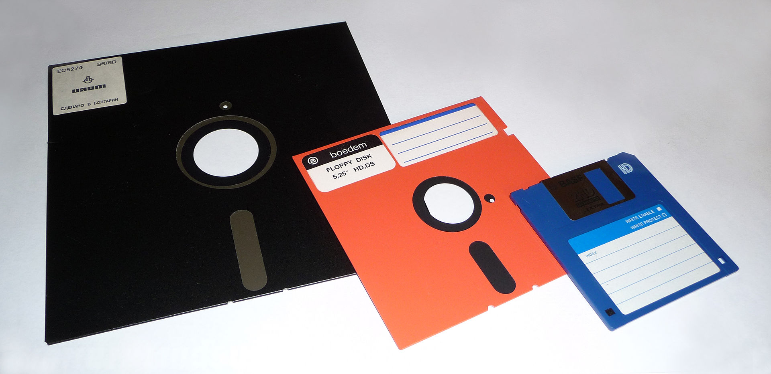

What do these have in common?
8GB (front) vs 8B (back)
Floppy disks (8”, 5 1/4”, 3 1/2”)
Compact disk
[Wikipedia]
Notes:
Magnetic

Slide 10
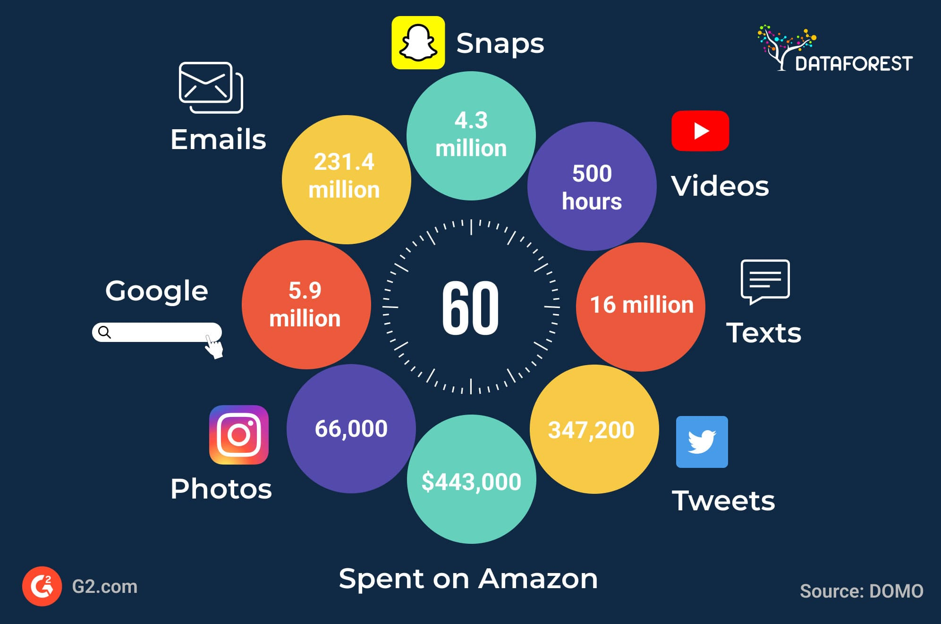
“Big Data”
The co-evolution of
storage capacity transmission capacity processing capacity
Dataforest.ai

Slide 11
Wikipedia definition
Data mining is the process of
discovering patterns in
large data sets
involving methods at the intersection of
machine learning,
statistics, and
database systems.

Slide 12

"Raw data" does not exist!
Data is a plural word ("the data are …") derived from the Latin word for "given"
— BUT —
"... data are never simply given [...]. How data are construed, recorded, and collected is the result of human decisions — decisions about what exactly to measure, when and where to do so, and by what methods."
Nick Barrowan: "Why Data Is Never Raw - On the seductive myth of information free of human judgment". The New Atlantic, 2018.

Slide 13
Informal definition
Given lots of data (collected by someone, for a reason, with a purpose) discover patterns and models that are:
Valid: hold on new data with some certainty
Useful: should be possible to act on them
Unexpected or novel: non-obvious
Understandable: interpretable
Complete: contain most of the interesting information
J. Leskovec, A. Rajaraman, J. Ullman: Mining of Massive Datasets, http://www.mmds.org

Slide 14
Example : 300 numbers
8.5998019 10.82452538 10.25496714 9.9264092 10.26304865 8.80526888 8.96569273 9.00883512 9.82813977 10.19311326 9.6545295 10.83958189 12.20970744 10.41521275 10.15902266 9.86904675 10.17021837 10.58768438 12.07341981 8.45713965 9.62152893 11.2494364 9.30073426 10.12753479 11.06429886 9.80406205 9.74418407 11.15815923 10.87659275 10.39190038 10.52911904 10.84125322 11.98925384 10.63545001 9.07420116 10.48011257 11.32273164 9.4831463 10.67973822 10.87064128 9.35940084 9.51149749 11.13211644 9.23292561 8.4767592 9.64339604 9.91374069 9.84184184 9.85576594 9.18523161 10.27107348 8.7511958 8.70297841 10.50609814 11.1908866 10.59484161 10.60027882 9.06375121 10.48534475 9.34253203 10.37303225 9.27441407 11.27229628 12.88441445 9.80825939 9.09844847 10.82873991 8.89169535 10.43092526 7.43215579 10.29787802 9.87946998 8.3799398 10.21263966 9.93826568 9.17325487 10.22256677 10.04892038 11.01233696 9.6145273 9.9495437 10.51474851 9.19288505 7.87728009 9.987364 10.94639021 10.01814962 9.40505023 8.87242546 10.23686131 8.90710325 10.31678617 10.4571519 9.04315227 9.85321707 11.89885306 6.99926999 10.71534924 10.29215034 10.59516732 9.8807174 9.01321711 8.45289144 9.1739316 7.90909364 9.42165081 10.37087284 9.57754821 9.60350044 10.75691005 8.24594836 10.33419146 9.7779209 9.51609087 10.25712725 12.1256587 9.53397549 9.44765209 9.53901558 9.8006768 9.633075 11.17692346 11.00022919 8.38767624 8.63908897 8.10049333 10.66422258 10.70986552 10.82945121 10.45206684 9.21578565 10.21230495 10.28984339 9.4130091 10.54597988 10.8042254 10.52795479 10.76288124 11.3554357 11.484667 10.36068758 8.18239896 11.20998409 9.88574571 9.8811874 10.64332788 8.67828643 9.23619936 10.71263899 9.36036772 8.80204902 8.84117879 9.60177677 8.82383074 9.85787872 10.30883419 10.09771435 10.33417508 8.94003225 9.63795622 8.88926589 8.51484154 10.61543214 10.10520145 10.23046826 11.22923654 10.25575855 10.4210496 9.79970778 7.70796076 9.56309629 10.82893108 10.4055698 10.12121772 9.38935918 9.48947921 9.53357322 9.87589518 10.5455508 9.98665703 9.440398 9.67368819 12.94191966 10.01303924 12.14295086 9.58399348 10.92799244 10.4654533 10.14613624 9.29818262 9.25613292 11.59370587 8.62517536 10.29703335 9.11065832 10.68766309 9.86507094 10.58314944 10.65232968 8.13400366 11.0414868 10.16883849 10.23649503 11.51859843 9.4754405 10.88103754 8.6249062 9.64581983 8.80660132 10.3794072 11.7687303 9.6768357 10.83753706 12.39138541 9.45756373 10.4746549 11.44321655 10.70109831 8.36186335 8.99123853 10.7221973 9.25735885 10.11287178 9.77908247 10.05372548 12.32358117 9.09128196 10.27487412 8.31704578 9.67337192 11.1712355 11.33146049 10.44967579 9.58649468 9.5908432 10.53829167 10.16738708 10.45433891 10.79223358 11.3936216 9.27709756 8.91159056 8.67186161 7.83968452 11.00207472 10.61085929 11.15868605 10.13873855 9.29370024 10.49794191 10.49884897 9.77150045 8.80503866 10.08775177 11.38167004 10.42724794 11.11626475 10.68890453 10.49280739 9.53675721 9.74560138 10.34343033 10.19711682 9.20212506 9.06407316 10.07228419 11.06791431 12.10523742 8.72119193 10.04645774 11.47090441 8.92472486 10.04585273 10.41149437 9.90118185 9.02229964 8.66708035 11.53976046 11.40609367 9.73014878 8.94607876 11.562354 9.58552216 9.74172847 9.64220948 9.69459042 9.58460199 11.14917832 9.49543794 9.46369271 10.16544667 9.92277128 9.61975057 11.11679747 9.42894032 9.25751891 11.44948256 8.16601628 10.11500258 9.42431821
What are these numbers?

Slide 15
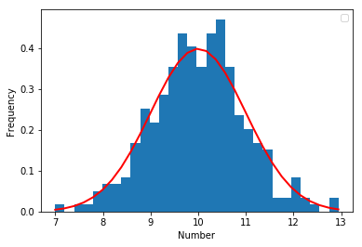
Example: 300 numbers (cont.)
Through statistical modeling we can find the data comes from a Normal distribution with mean 10 and standard deviation 1
Normal(μ=10,σ=1) is a model for the data

Slide 16

import numpy as np
import matplotlib.pyplot as plt
mu=10
sigma=1
sample = np.random.normal(mu, sigma, 300)
out, bins, ignored = plt.hist(sample, 30, density=True)
plt.plot(bins, 1/(sigma * np.sqrt(2 * np.pi)) * np.exp( - (bins - mu)**2 / (2 * sigma**2) ), linewidth=2, color='r')
plt.xlabel("Number")
plt.ylabel("Frequency")
plt.show()

Slide 17
Challenges
Usage
Quality
Context
Streaming
Scalability
Collect
Prepare
Data
Modalities
Represent
Ontologies
Text
Signals
Networks
Structured
Multimedia
Model
Reason
Visualize
Data Operators
J. Leskovec, A. Rajaraman, J. Ullman: Mining of Massive Datasets, http://www.mmds.org

Slide 18
Describing vs Predicting
Descriptive methods
Find human-interpretable patterns that describe the data
Example: clustering, association rule mining
Predictive methods
Use some variables to predict unknown or future values of other variables
Example: recommender systems, time series forecasting

Slide 19
Characterizing vs Distinguishing
Data characterization methods
A summary of the general characteristics or features of a target class of data
Data discrimination methods
A comparison of the general features of the target class data objects against the general features of objects from one or multiple contrasting classes

Slide 20
Data mining has several goals
To produce a model
E.g., a regression model for a numerical variable, or a classification model for a categorical variable
To create a summary
To extract prominent features

Slide 21
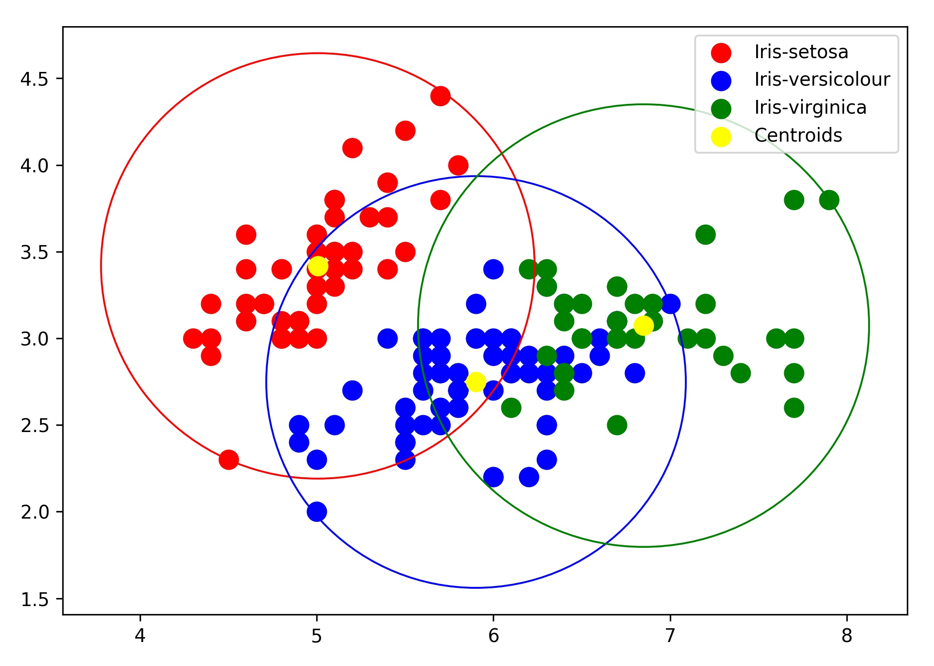

Example summary: clustering
Sepal width
Sepal length

Slide 22
Picking the right features
Representing these flowers by their sepal length and sepal length was key
These come from domain expertise
Other features such as color or number of leaves may not be so good
Feature selection is key!

Slide 23
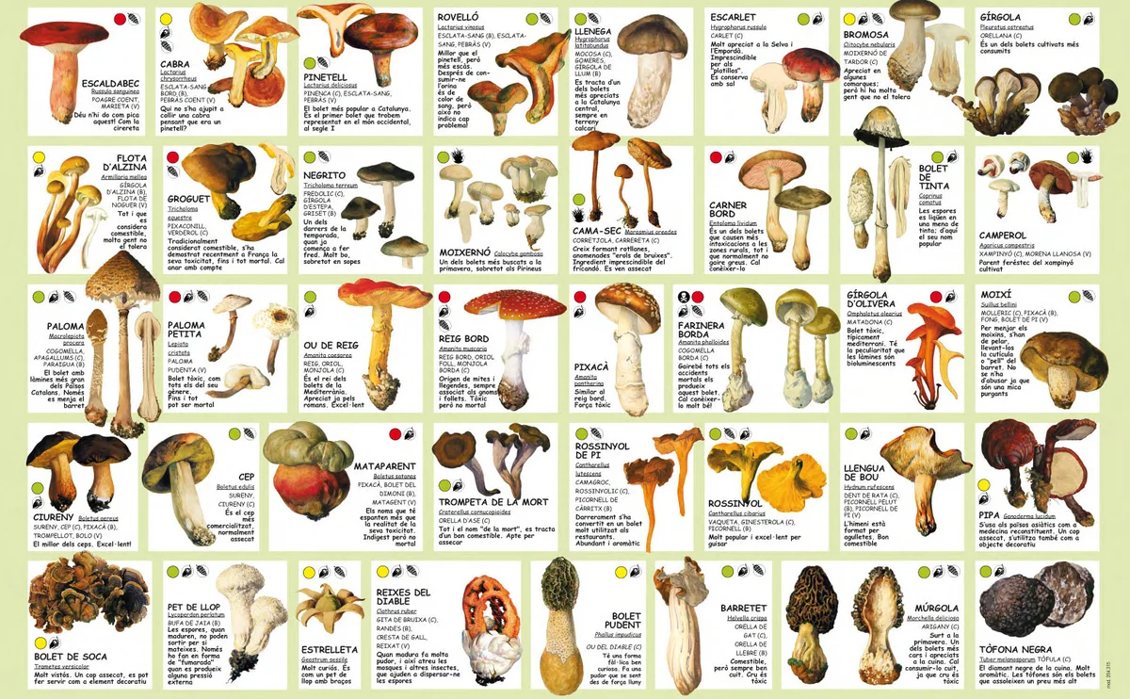
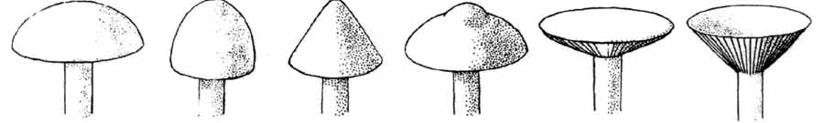

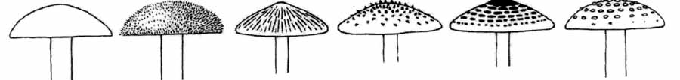
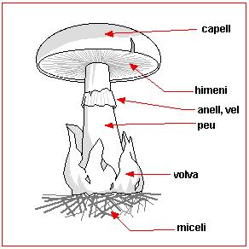
Features: a matter of life or death

Slide 24
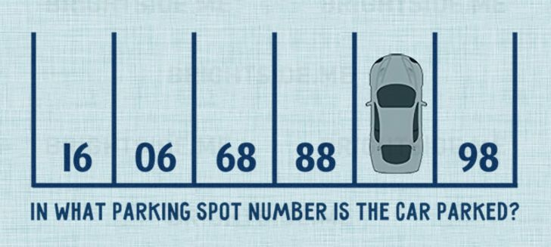
Another pattern-finding example
Source: centauro.net (2017)

Slide 25

Example: complex features
Given shopping baskets of previous customers, determine:
Frequent itemsets (bought together)
Similar items (e.g., for recommendations)

Slide 26

Risk #1: Spurious patterns
A risk with “Data mining” is that an analyst can “discover” patterns that are meaningless
If you look in more places for interesting patterns than your amount of data will support, you are bound to find something (~Bonferroni principle)
If you interrogate data
hard enough it will tell you what you want to hear

Slide 27
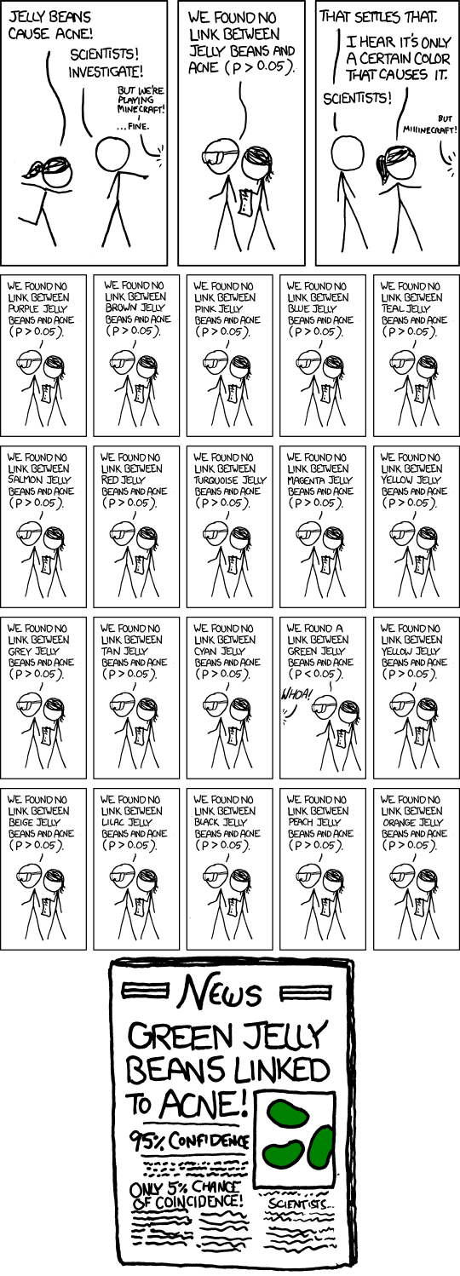
Risk #1: Spurious patterns

Slide 28
Risk #1: Spurious patterns (cont.)

Slide 29

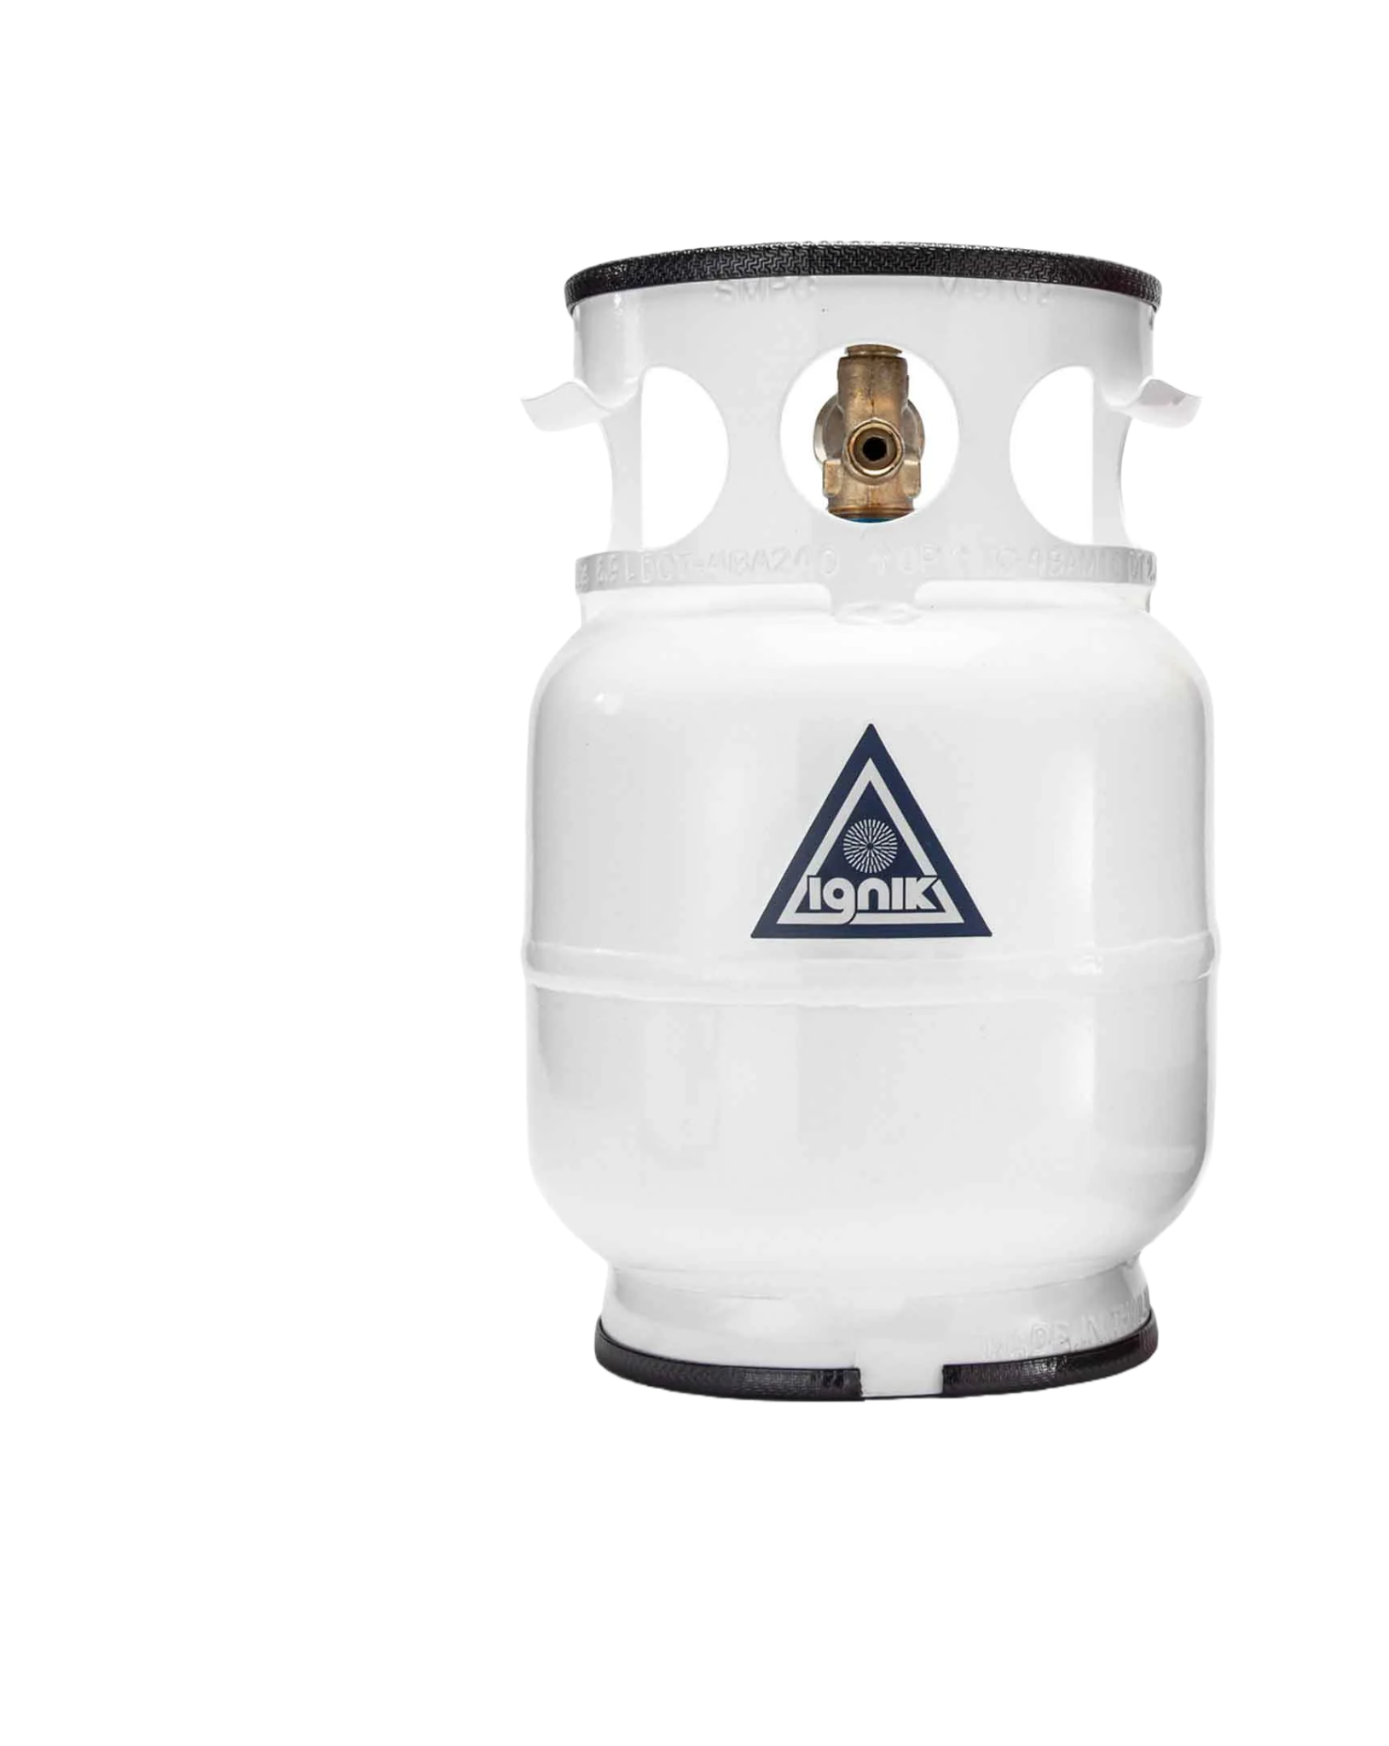

Risk #2: Data spills/leaks/breaches
Unwanted disclosure of personal information
The safest prevention is to avoid collecting large amounts of potentially harmful data
Typical causes
human error,
system vulnerabilities,
external/internal attacks, etc.
≠
Image: Enov8

Slide 30

Risk #3: Surveillance
Attention-grabbing evil actions are also very rare, with consequences:
Suppose 1 in a million in a suicide bomber
Catching one suicide bomber a year on average means examining 999.999 innocent people
A system with 1% false positive rate will flag ~10K people as potential suicide bombers
Image: Red Bubble

Slide 31
Data mining (DM) vs other disciplines
If you study …
Databases: DM means analytic processing
Machine learning: DM means modeling
Algorithms: DM means ensuring scalability
Our focus will be on scalable algorithms

Slide 32
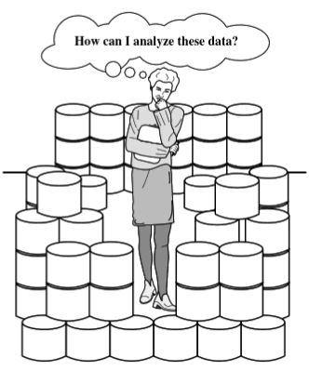
Data rich but information poor
Fast-paced data streams become data archives that become data tombs
Decisions could be supported by data that has already been collected (by someone, with a purpose) but is hard to “mine”
Or new data might be required
Data Mining Concepts and Techniques, 3rd edition (2011) by Han et al.

Slide 33
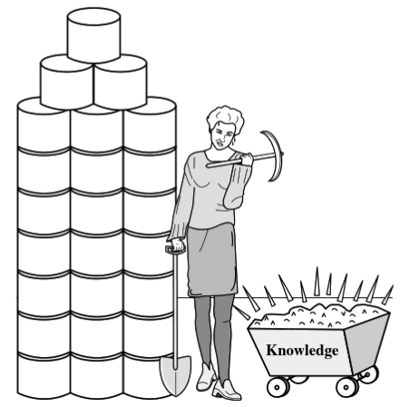
Knowledge Discovery from Data
KDD, a popular acronym
“Discovery” is Data Mining
Other names: knowledge mining from data, knowledge extraction, data/pattern analysis
Data Mining Concepts and Techniques, 3rd edition (2011) by Han et al.

Slide 34
Typical stages of KDD
Data Cleaning
Data Integration
Data Selection
Data Transformation
Data Mining ← application of a DM algorithm
Pattern Evaluation
Knowledge Presentation

Slide 35
Typical stages of KDD
Data Cleaning
Data Integration
Data Selection
Data Transformation
Data Mining
Pattern Evaluation
Knowledge Presentation
Pre-processing phase
Analytical phase

Slide 36
Summary

Slide 37
Things to remember
Define:
Describing vs Predicting
Characterizing vs Discriminating
Describe the stages of the KDD process

Slide 38
A fun pet project for the trimester?
Just for fun, what is the silliest thing in your own life you could dataify and analyze?
Think of a fun pet project worthy of a data scientist
No need to show it to me or to anyone!
Or maybe make a video and go viral!
Do not capture personal data without consent
Make it fun, silly, quirky, wholesome

Slide 39

Additional contents (not included in exams)

Slide 40
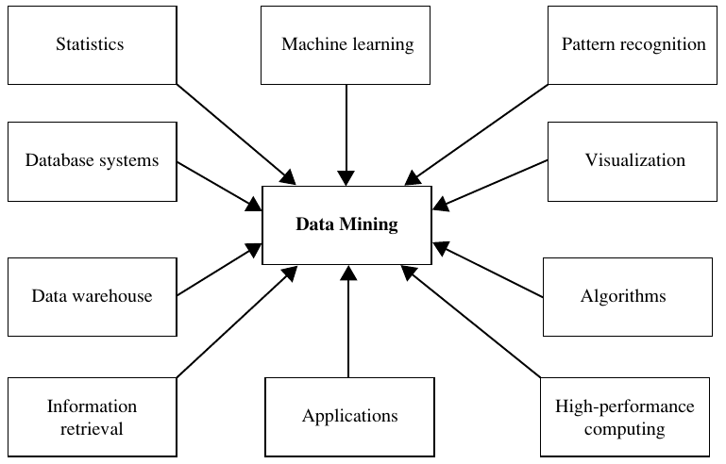
Data Mining Concepts and Techniques, 3rd edition (2011) by Han et al.

